Slide 1
WELCOME TO….

Slide 2
COMMUNICATION TECHNOLOGY QUIZ
BY,
Krithika, Isha, Disha, and Vaishnavi

Slide 3
RULES
This quiz consists of 6 questions.
You will be given 10 secs to answer each question.
Each question carries 5 points. Thus, this quiz is for 30 points.
There is no negative marking.
--- ALL THE BEST!!! ---

Slide 4
Question 1: Which company for the first time acquired 60 million subscribers within the first month of commercial operations? (a) Airtel (b) Vodafone (c) Reliance Jio (d) Tata Docomo

Slide 5
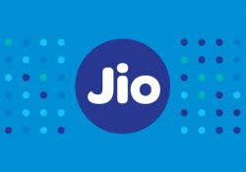
Answer 1: (c) Reliance Jio

Slide 6
Question 2: Tokyo Tsushin Kogyo is commonly known as______ . (a) Samsung (b) Sony (c) Panasonic (d) Canon

Slide 7
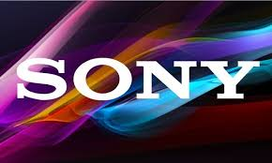
Answer 2: (b) Sony

Slide 8
Question 3: Backup Rub is commonly known as ______. (a) Virool (b) PaperG (c) Praytell Strategy (d) Google

Slide 9

Answer 3: (d) Google

Slide 10
Question 4: Which video game is banned in Saudi Arabia as it had characters resembling The Cross and Star Of David? (a) Pokemon (b) Yo Kai Watch (c) Sulkoden (d) Dragon Quest Monsters

Slide 11

Answer 4: (a) Pokemon

Slide 12
Question 5: The company was found in 1901 in Japan. The company’s name was coined from two Kanji characters meaning Sun and Rise. Name the company. (a) Hitachi (b) Mitsubishi (c) Toshiba (d) Haier

Slide 13

Answer 5: (a) Hitachi

Slide 14
Question 6: Which company is designing a bacteria free smartphone for hospital workers since 20%-30% of bacteria are transferred between a cellphone and a finger? (a) Vivo (b) Motorola (c) Nokia (d) BlackBerry

Slide 15

Answer 6: (d) BlackBerry

Slide 16
THANK YOU

